Slide 1

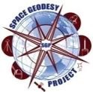
Goddard Geophysical and Astronomical Observatory
Jan McGarry
NASA Goddard Space Flight Center
November 5, 2020

Slide 2
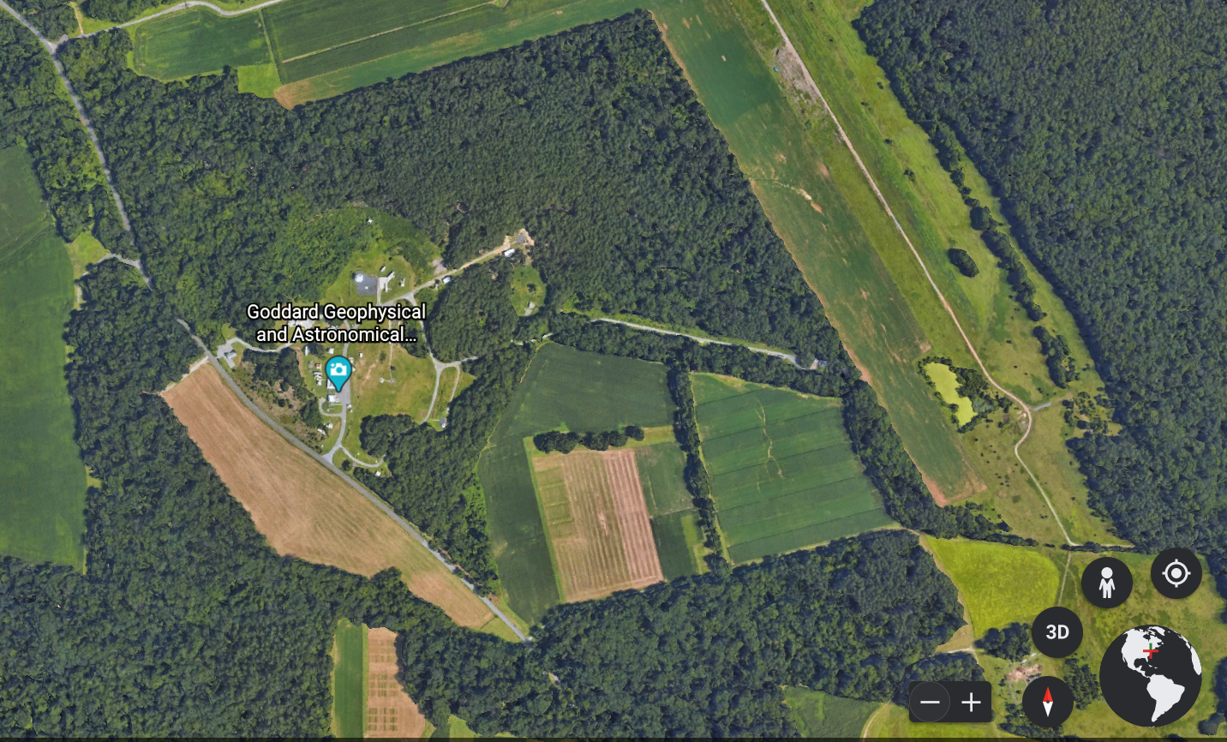
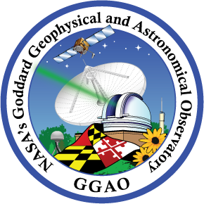

Goddard Geophysical and Astronomical Observatory (GGAO)
Google Earth

Slide 3
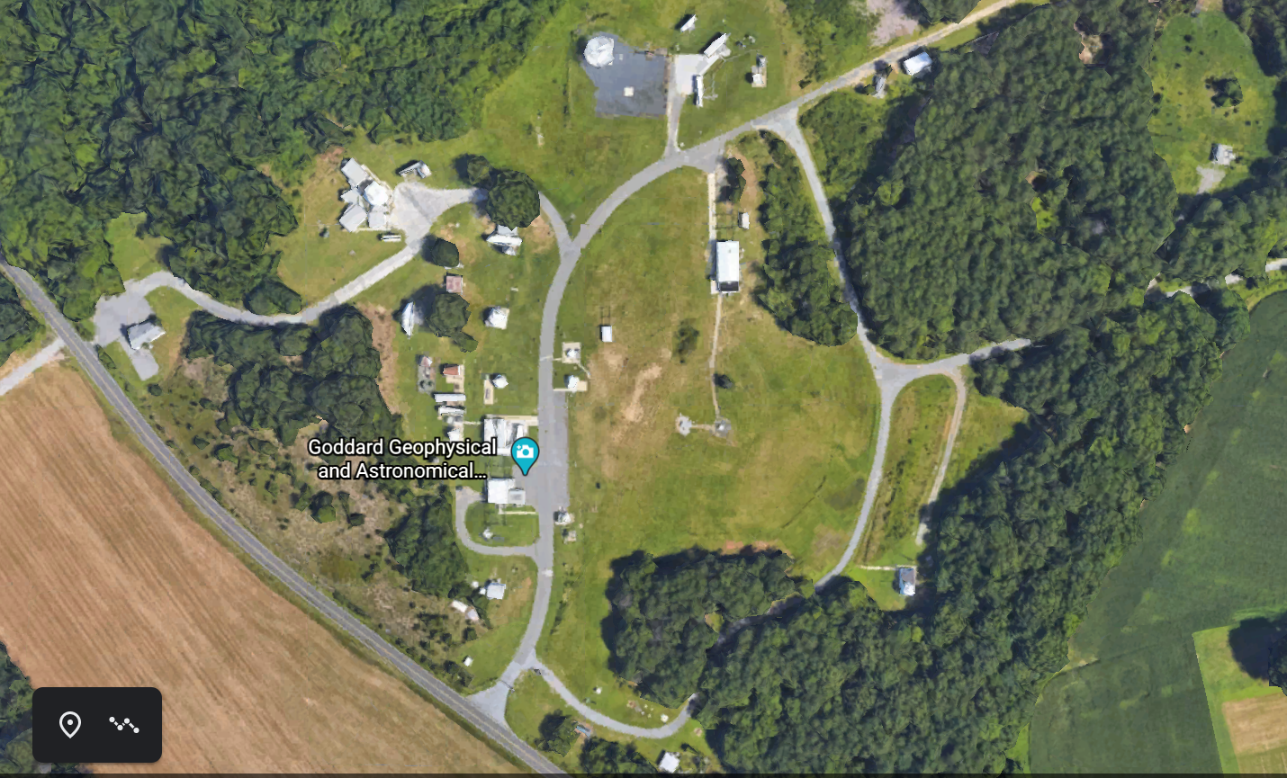
Goddard Geophysical and Astronomical Observatory (GGAO)
Located in the middle of the Beltsville Agricultural Research Center (part of the U.S. Department of Agriculture), the site is approximately 4.5 km from the Goddard main campus. GGAO is home to many Goddard optical / laser research activities.
Google Earth

Slide 4
NASA’s Space Geodesy Project (SGP) – Stephen Merkowitz
All four geodetic techniques are located at GGAO:
  Satellite Laser Ranging (SLR)
  Very Long Baseline Interferometry (VLBI)
  Global Navigational Satellite System (GNSS)
  Doppler Orbitography and Radiopositioning Integrated by Satellite (DORIS)
More details on all of these in other parts of the GGAO virtual tour
There are many other experiments and activity going on at GGAO. The following slides will discuss some of these.

Slide 5
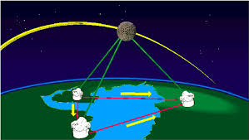
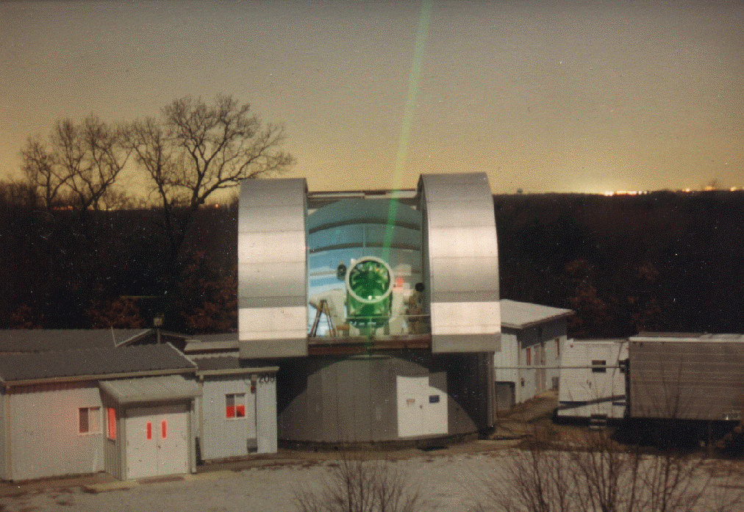
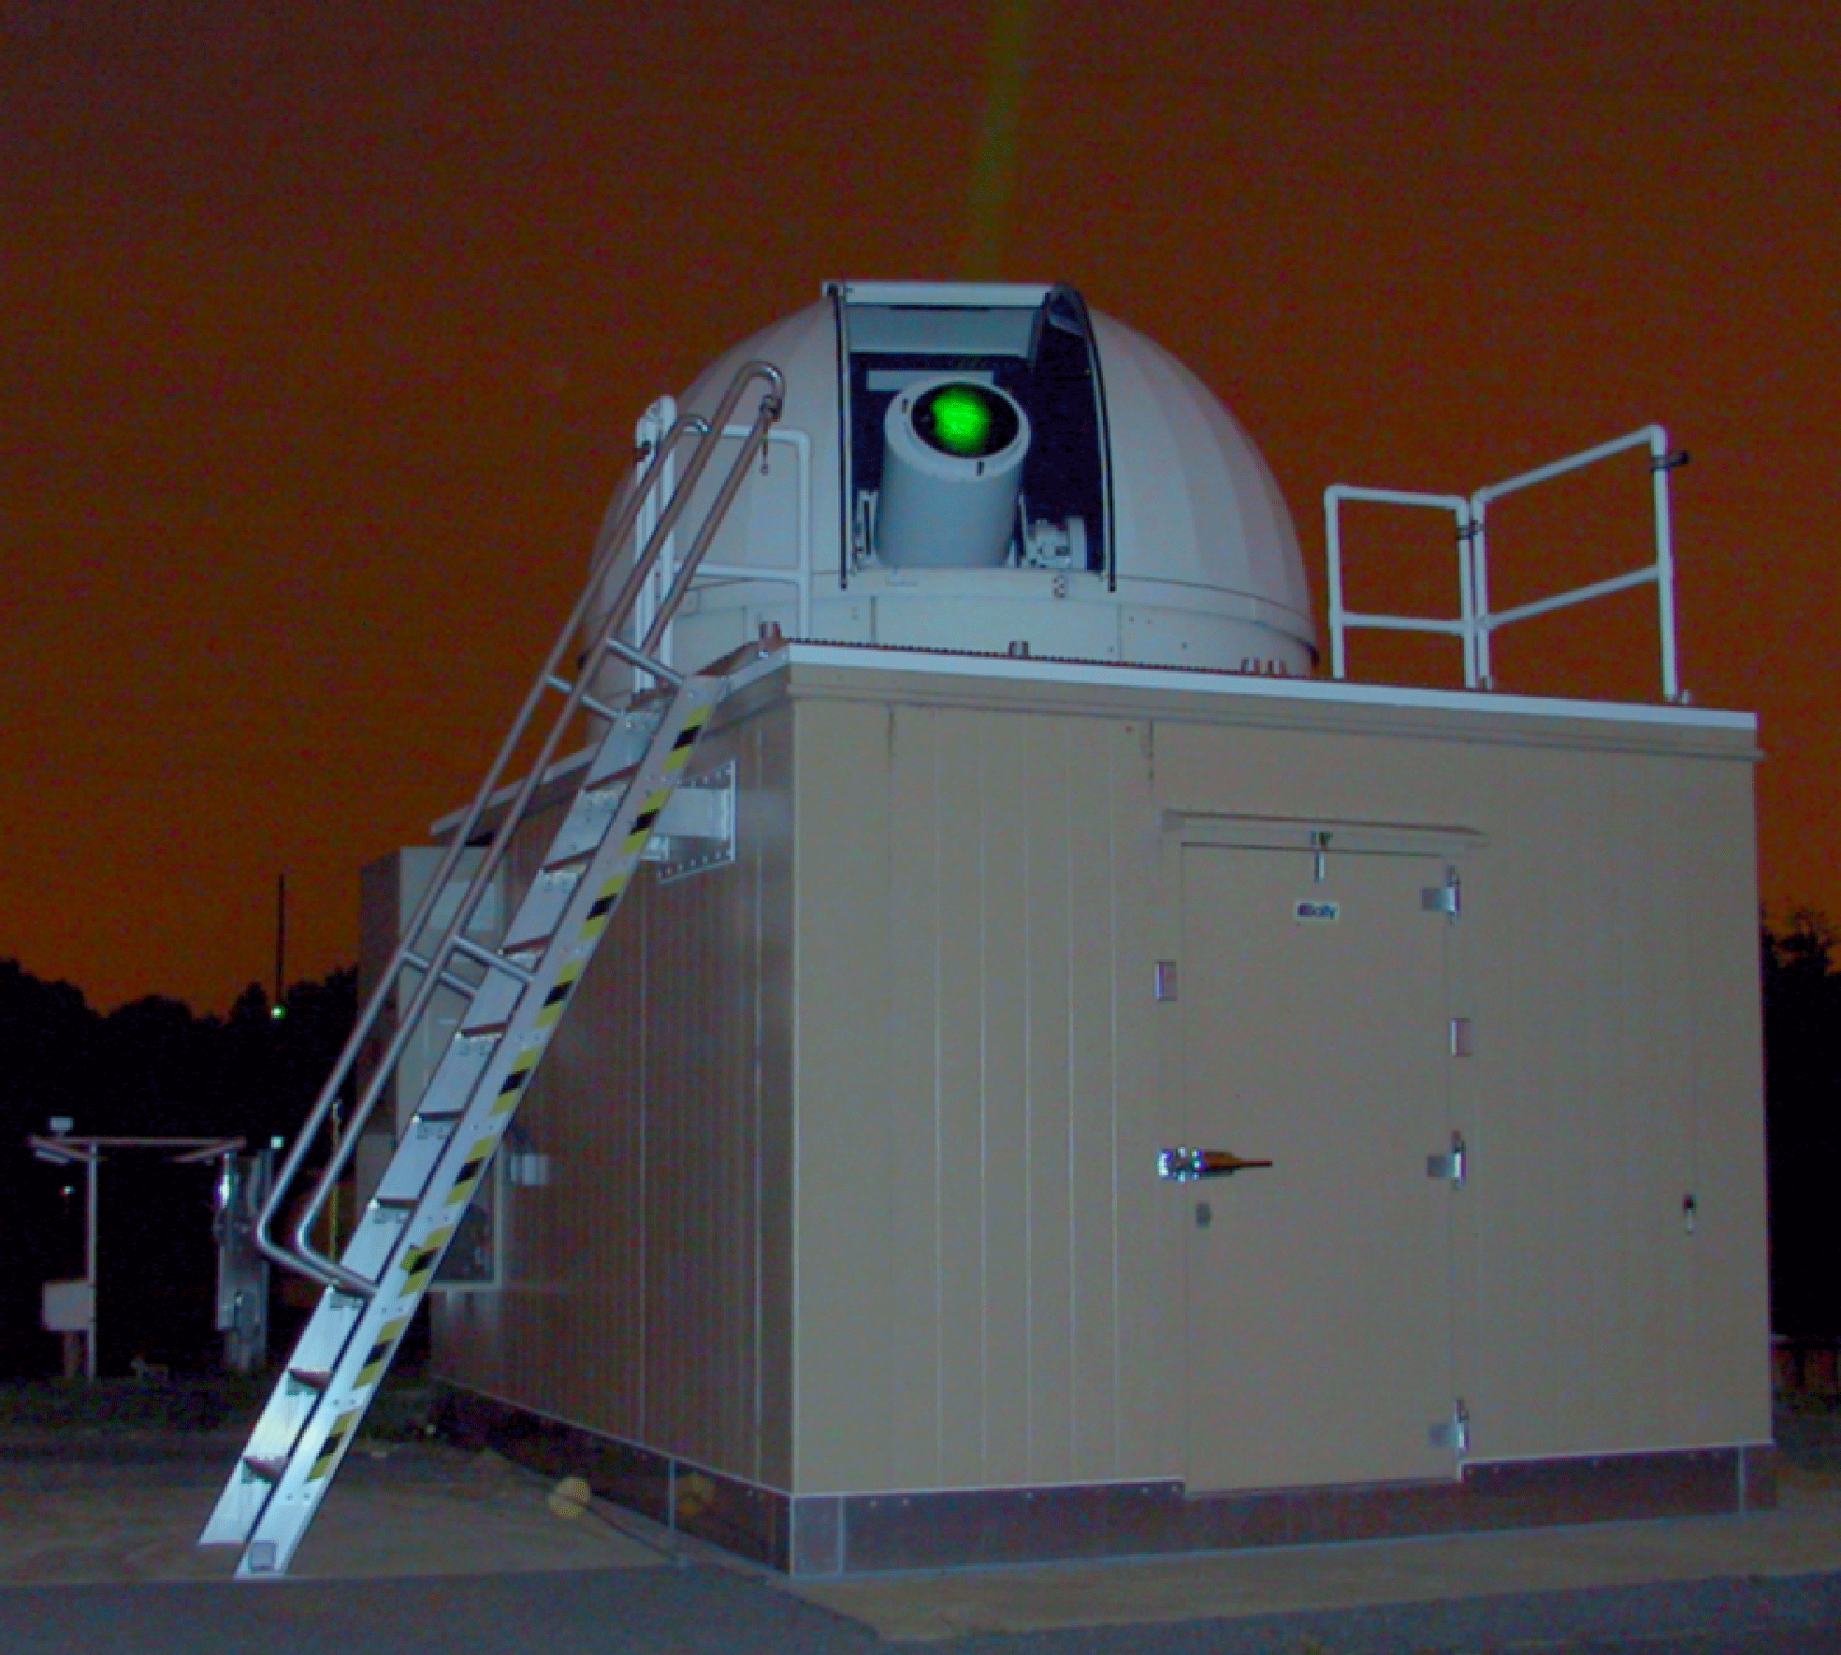
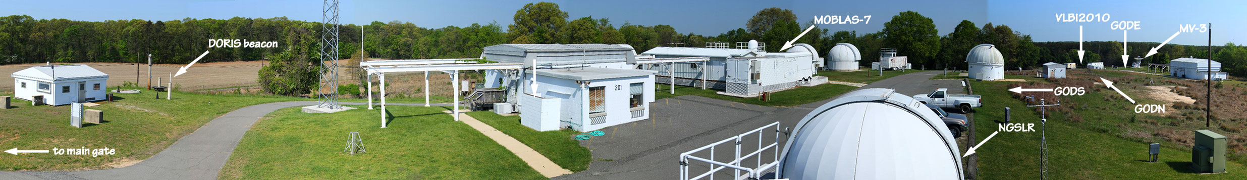
Satellite Laser Ranging (SLR) at the
Goddard Geophysical and Astronomical Observatory (GGAO)
The first ground station to detect laser
light reflected by satellites (1964)
A unique observatory with four geodetic measurement techniques at one location − SLR, VLBI, GNSS, DORIS
Site of NASA SLR technique and system developments
Site of the first planetary laser ranging/communications to MESSENGER, MGS, and LRO
1.2-m telescope facility
NGSLR

Slide 6
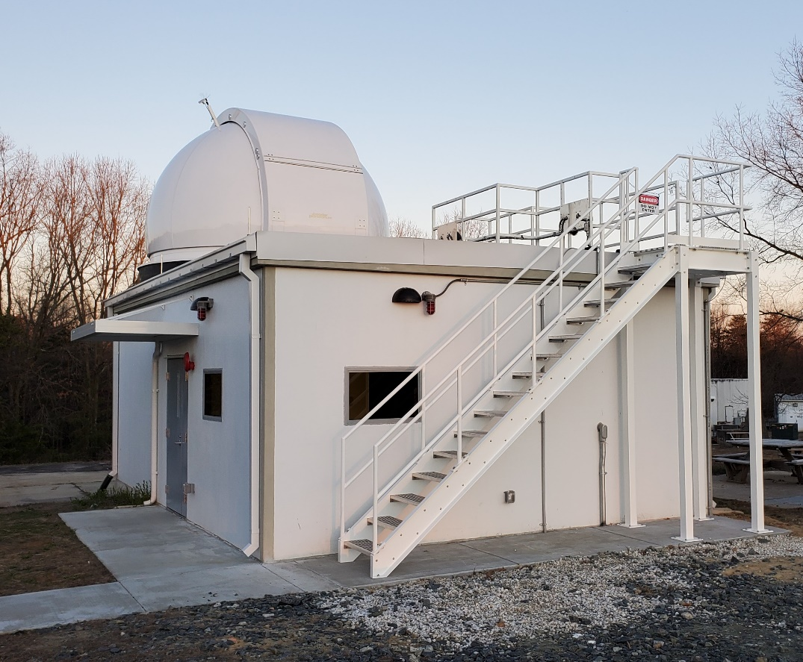
Space Geodesy Satellite Laser Ranging (SGSLR) Systems –
Jan McGarry & Evan Hoffman
NASA’s next generation satellite laser ranging stations (SGSLR) are being developed, built and tested at GGAO. These systems will replace and augment the SLR stations in NASA’s legacy SLR network.

Slide 7
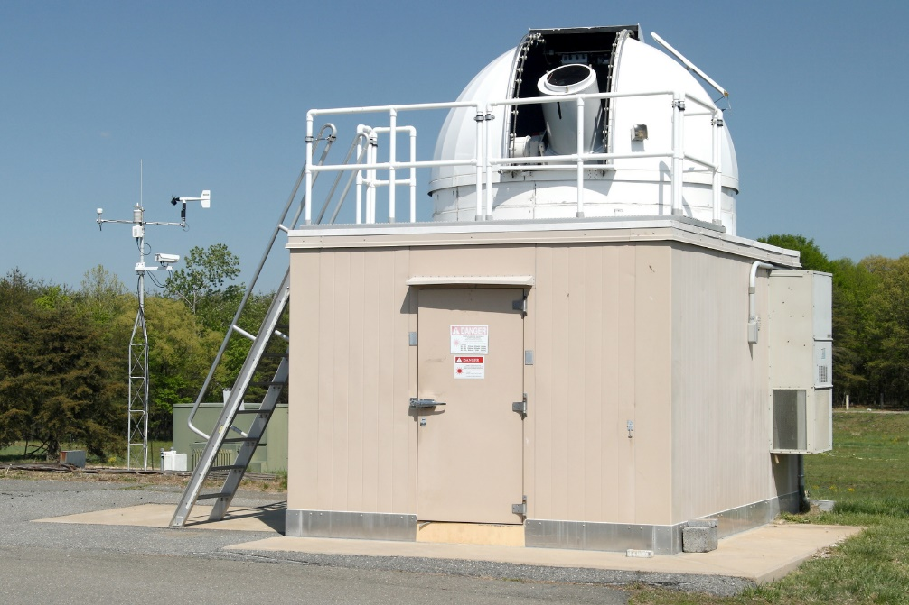
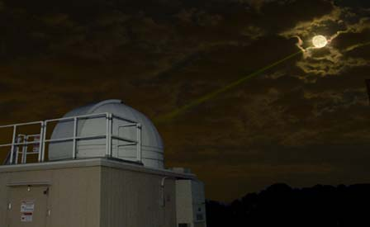
NGSLR: Prototype for the SGSLR system – Jan McGarry
NGSLR was developed as a prototype for the SGSLR systems that are now being produced.
It also was one of 10 ILRS stations performing operational one-way laser ranging to the Lunar Orbiter Laser Altimeter (LOLA) onboard the Lunar Reconnaissance Orbiter (LRO) from 2009 to 2014.

Slide 8
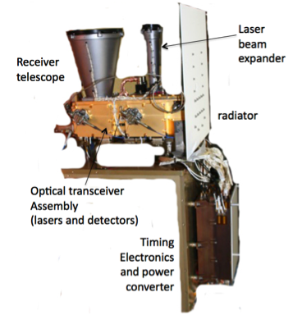
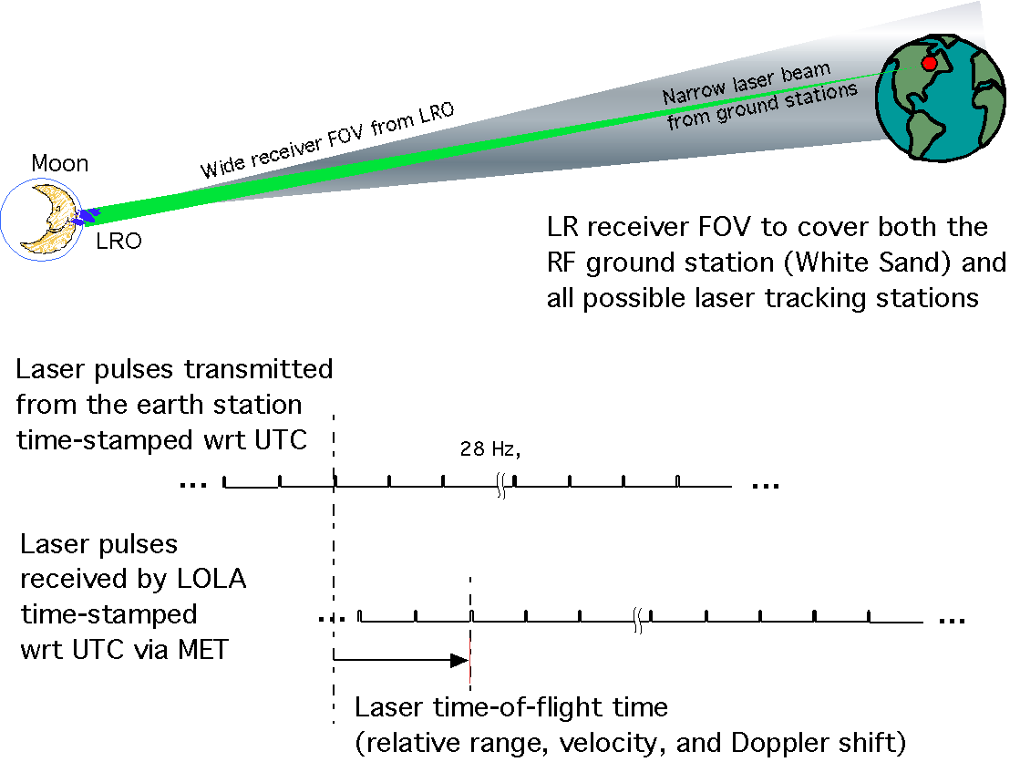
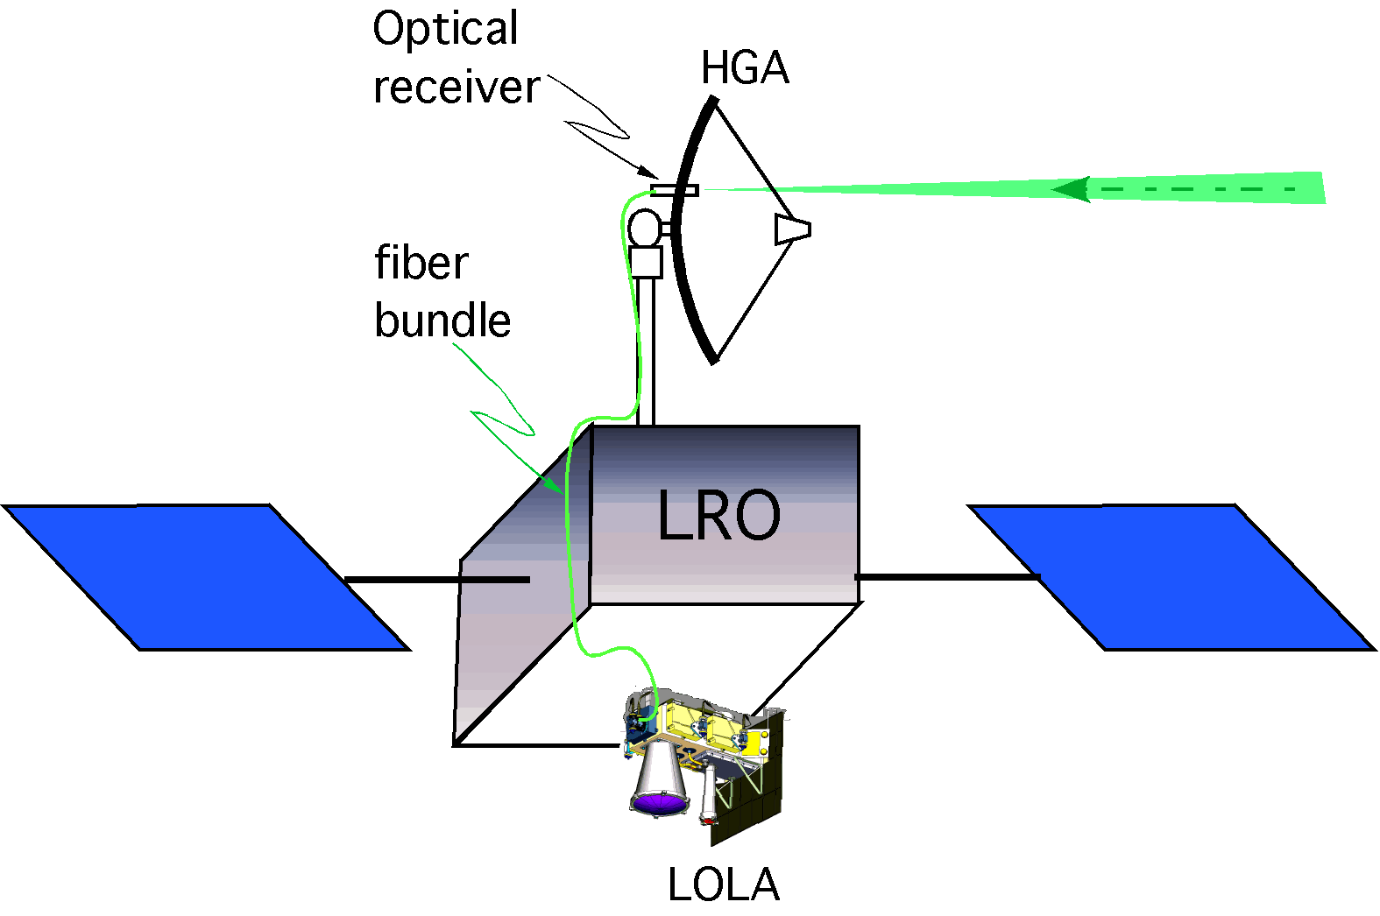
Lunar Reconnaissance Orbiter (LRO)
Laser Ranging (LR) System – Xiaoli Sun
Lunar
Orbiter
Laser
Altimeter
(LOLA)
One-way laser ranging from Earth to LRO riding on HGA for Earth pointing;
Using LOLA for laser pulse time stamping with a 8-ms LR range window at 28 Hz and synchronized with s/c MET
LOLA time tags the first received pulse within the range window.
Notes:
Our chance finally came in 2009. United States launched a lunar probe called Lunar Reconnaissance Orbiter, or LRO, which is still in orbit today. We have a lidar on LRO to map the surface of the moon, look for water ice, and search for future landing sites. We managed to convince the LRO project manager to let us add a one-way laser ranging system on board to help with the orbit determination. We asked them to cut a hole on the antenna for us to put a small telescope and run an optical fiber down the wire conduit done the antenna boom along with other cables. We connected the optical fiber to one of our detector on our lidar to detect and time stamp laser pulses from Earth. We also convinced the spacecraft to buy the most expensive quartz oscillator as the clock. This enabled our satellite laser ranging stations on ground to shoot lasers at LRO whenever the spacecraft is downloading data to Earth. With good clocks at both ends, we can measure relative distance and motion between the ground station and the spacecraft from the time stamps of the transmitted and the received laser pulses.
We did not tell any one that this one-way laser ranging system also provided us a test bed for laser communications. We can simply use the pulse position modulation to dither the uplink laser pulses, just like we did in my thesis. It is even better that the LRO is already pay for the laser ranging operation, we can do laser communication at no cost and no management supervision.

Slide 9
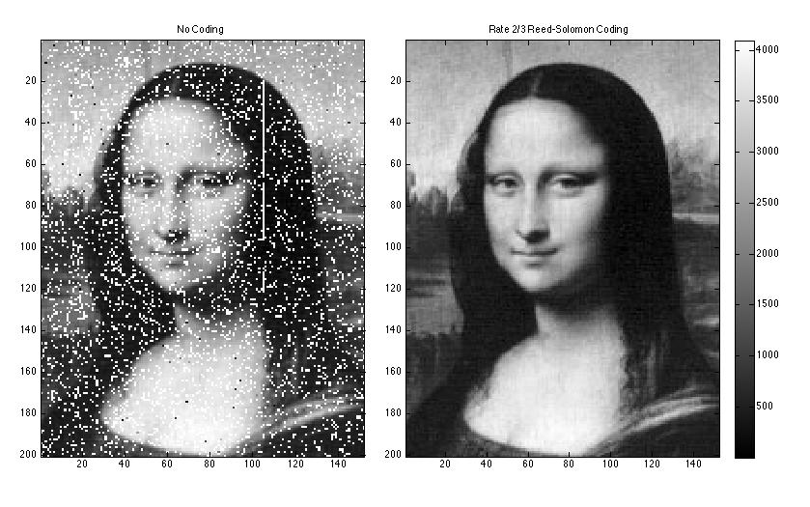
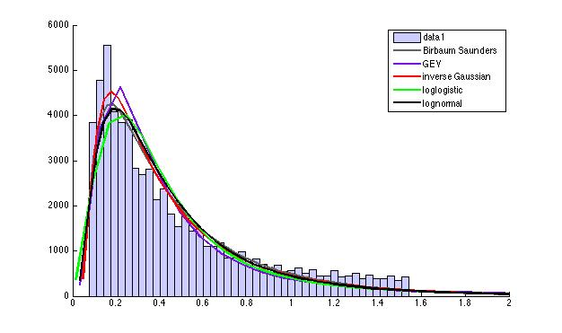
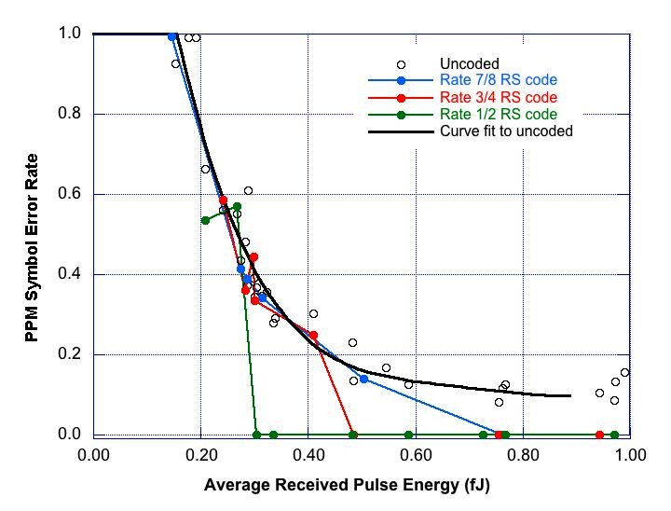
Successful Demonstration of Simultaneous Laser Ranging and Error-Free Communication
at Lunar Distance – Xiaoli Sun
Sample LRO-LR communication data, March 2012
Atmosphere Fading
Coding Gain
Without error
correction coding
With Rate 2/3 Reed-Solomon
error correction coding
Atmosphere fading effect follows a log-normal distribution, as expected.
Error correction coding is necessary for error-free data transmission.

Slide 10
NASA’s 1.2m Telescope – Evan Hoffman & Jan McGarry
This facility was built in-house at Goddard and was completed in 1974. The telescope was built by Kollmorgen.
Used for many research activities over the decades including pioneering work in SLR and deep space laser ranging, e.g., 2-color SLR, Earth to Mars laser link.
Used by Goddard and various Universities, especially Univ. of Maryland.
System successfully performed ranging to planetary spacecraft to do post-launch characterization of the laser altimeter instruments onboard:
  Two-way asynchronous transponder laser ranging at 24 Mkm to the Mercury Laser Altimeter (MLA) instrument onboard the Messenger spacecraft on its way to Mercury (X.Sun: 2005).
  One-way laser ranging at ~80 Mkm to the Mars Obiter Laser Altimeter (MOLA) instrument onboard the Mars Global Surveyor (MGS) spacecraft while MGS was orbiting Mars (J.Abshire: 2005).
  Multiple two-way asynchronous transponder laser ranging to the Lunar Orbiter Laser Altimeter instrument on the Lunar Reconnaissance Orbiter (LRO) orbiting the moon (X.Sun: 2009, 2014, 2017).

Slide 11
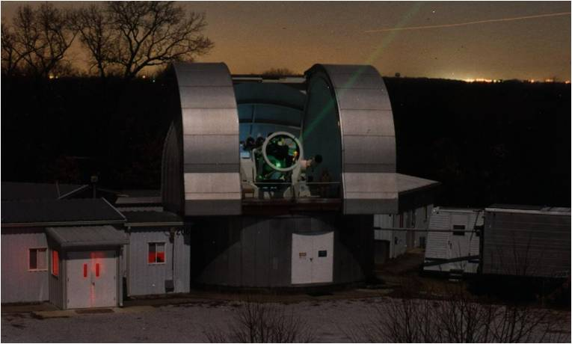
1.2-meter Telescope at GGAO
System parameters:
1.2 m (48”) dia. primary mirror
32 m effective focal length, F/27
Elevation and azimuth two-axes gimbal system with pressurized air azimuth bearing
2 degrees/s max. slew rate
5-mirror Coude, multi-ports
1-arcsecond pointing accuracy
~50% optical transmission
Tracking satellites at 800 to 22000 km altitude
Newly upgraded encoders
Newly upgraded timing system
Delgado, SPIE 0044, 1974

Slide 12


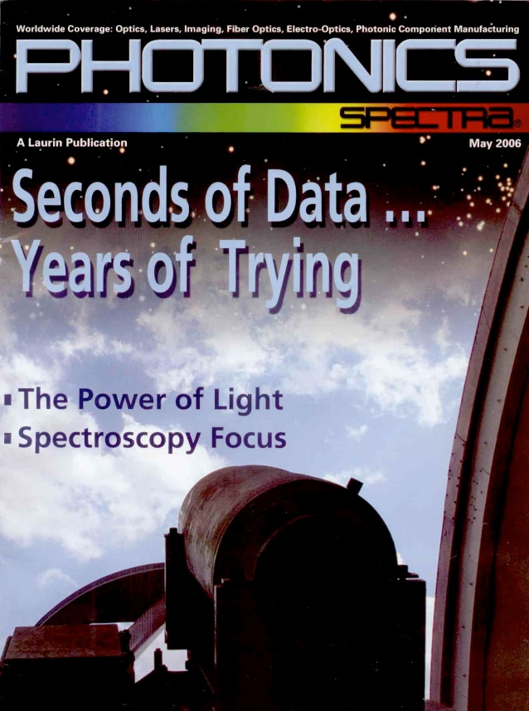
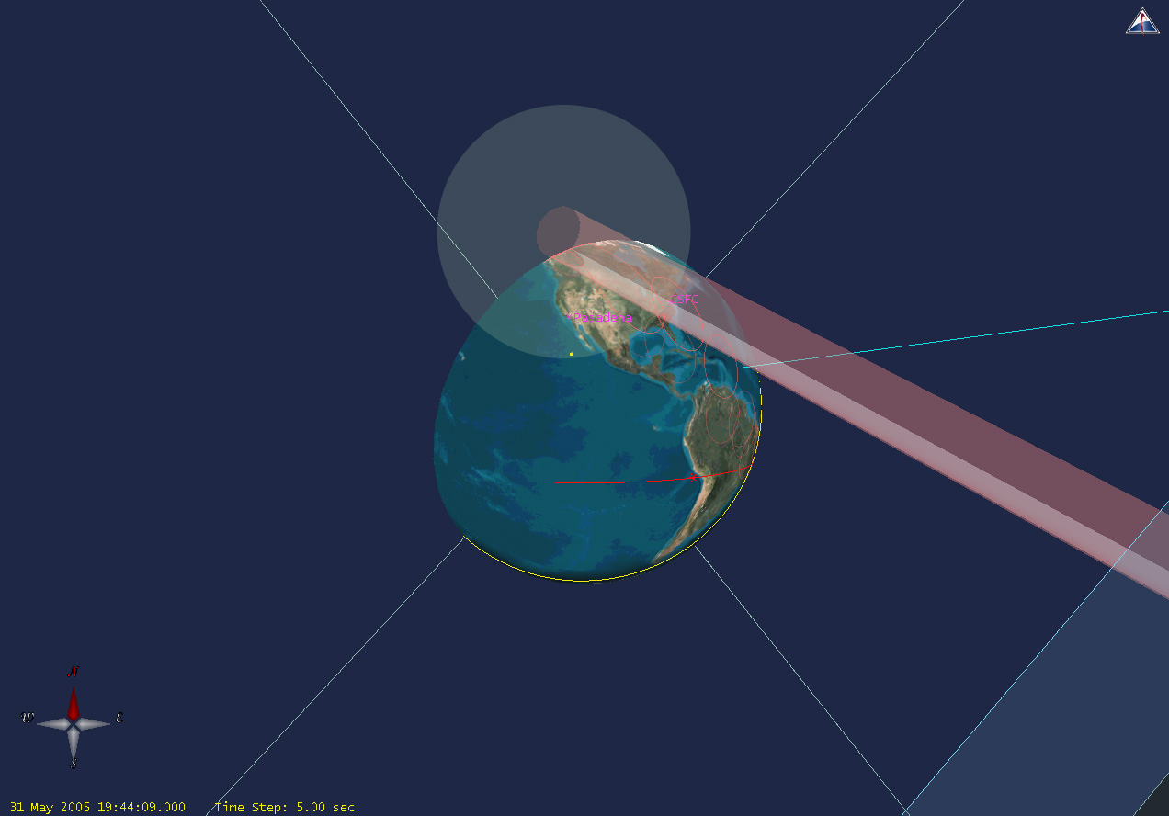
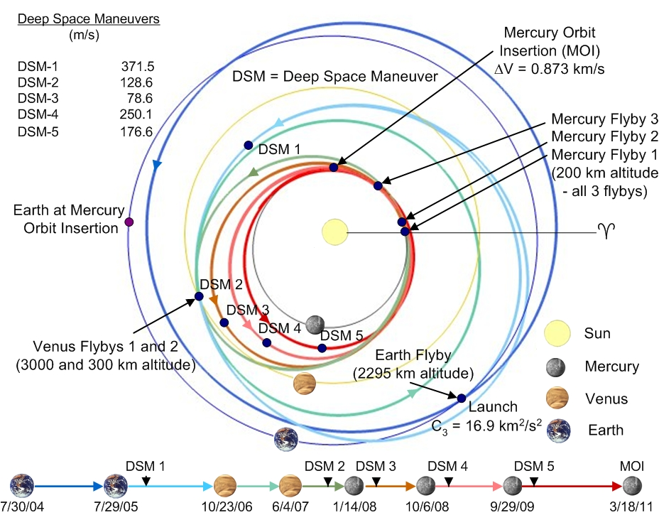
First Successful 2-way Laser Ranging between
GGAO and MESSENGER in 2005 – X. Sun
MLA calibration during the first MESSENGER Earth flyby over 24 million km distance in May 27 and 31, 2005.
Laser footprint
Receiver FOV
Delgado, SPIE 0044, 1974
MLA laser pointing:
Raster Scan (3.2 by 3.2 mrad):
100 lines at 16 urad/s,
(5 s laser illumination time
on any Earth station)
and 32 urad line spacing.
Spacecraft position seen from the Earth station:
60º from the Sun, 25-30º elevation, 1-5 pm local time, and 24,000,000 km (~80 sec light time).

Slide 13
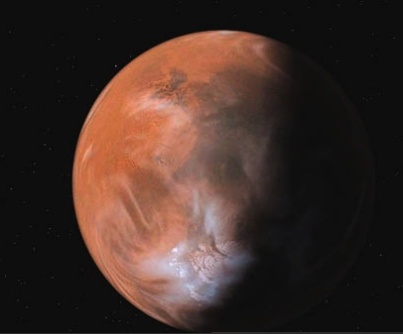

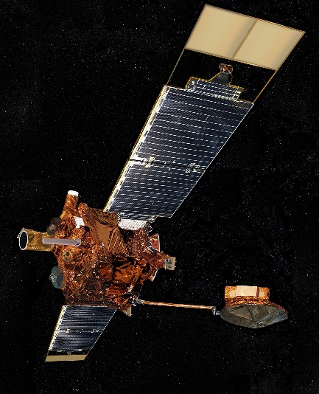
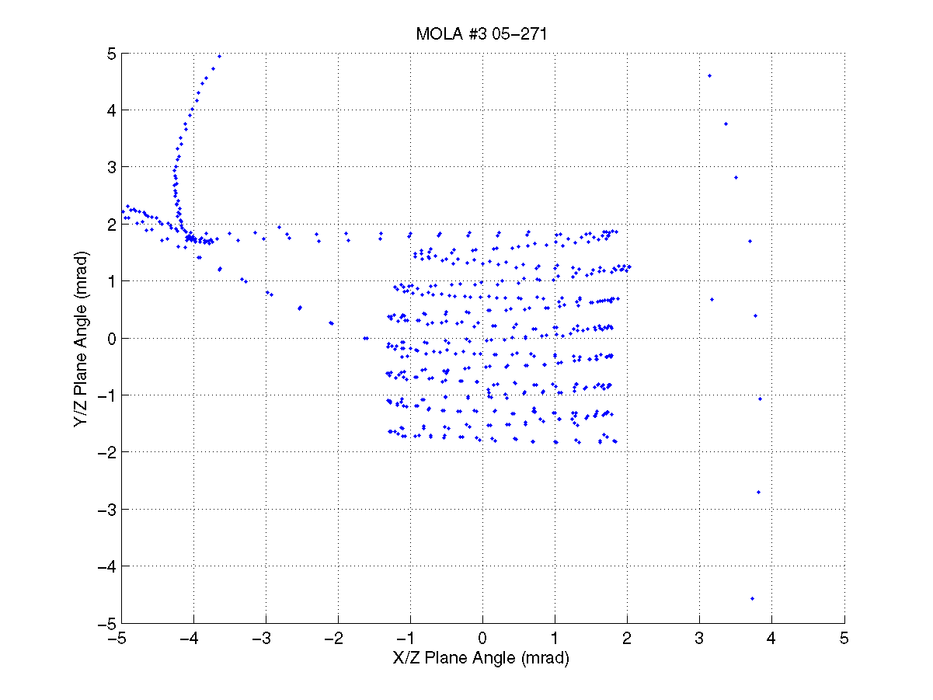
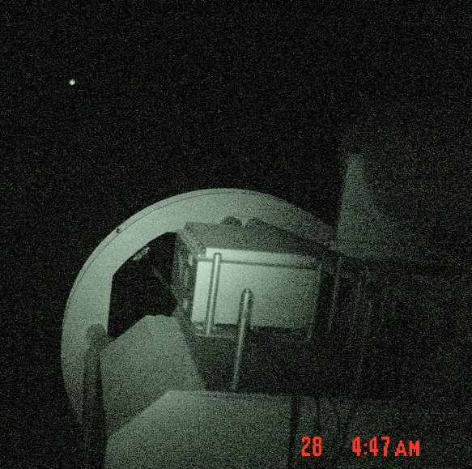
Earth to Mars One Way Laser Link Test – J. Abshire
Sep. 28, 2005
80.1 million km
Light time = 267.2 seconds
MGS: Two Earth scans/sessions
Each scan
~15 minutes each
Approx size of MOLA detector FOV (0.85 mrad, 2-3 times Earth)

Slide 14
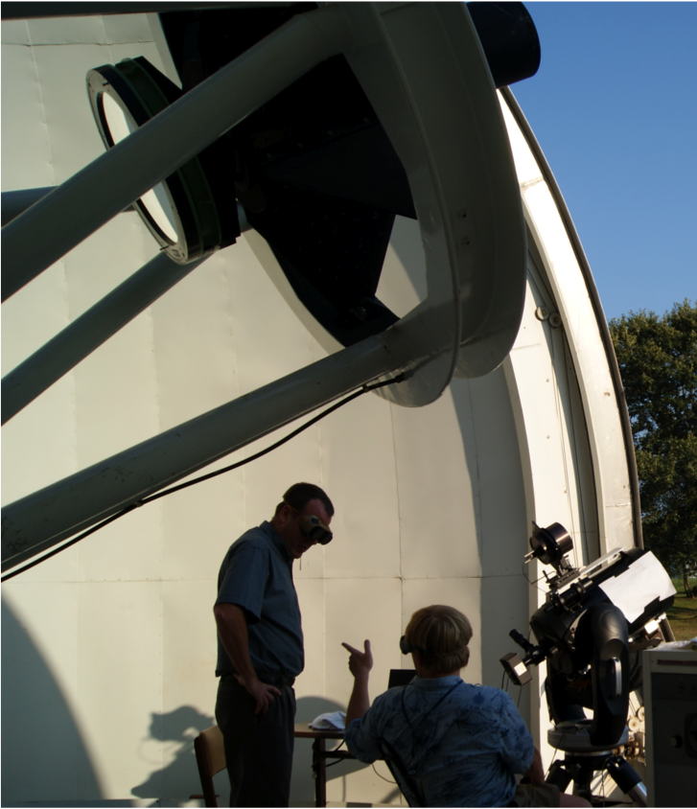
LOLA On-orbit Bore Sight Calibration in 2009 – X. Sun
Two-way laser ranging test between LOLA and SLR station on Earth in Aug. 25, and Sept. 13-14, 2009
  Scanning the LOLA laser beam about the SLR station at NASA GSFC
  SLR station tracking LOLA and transmitting and receiving laser pulses
  Solving LOLA pointing and boresight from the time tags of the laser pulses
  Recording LOLA laser pulse energy and pulse shape using an oscilloscope
Uplink signal detected by LOLA (folded into Ch1 FOV)
Downlink signal detected by the 5” telescope
A 5”diameter telescope mounted on a Celestron telescope was also used as the downlink receiver to verify the link margin
The test results verified DOE far field pattern and revealed a bore sight shift at low temperature
NASA GGAO 1.2 m Telescope Facility
(8/24/2009)

Slide 15
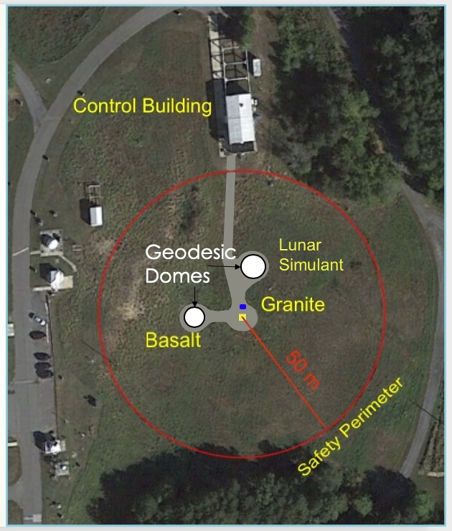
Gamma ray Neutron Testing Facility (GNTF) – Ann Parsons
Future landed Planetary Science instruments such as DraGNS on the selected Dragonfly mission to Titan and the BECA instrument for lunar exploration will use high energy neutrons and gamma ray spectrometers to measure the surface and near-subsurface bulk elemental composition on other planets.
When placed on a lander or rover, a Pulsed Neutron Generator (PNG) can be used as an intense source of high energy (14 MeV) neutrons to stimulate the planetary materials and cause them to emit gamma rays. The measurement of these gamma rays yields the elemental composition information.
Unfortunately, high energy neutrons are a radiation hazard and so it is not possible to test these instruments inside a normal laboratory. The Gamma ray-Neutron Test Facility (GNTF) at GGAO provides a safe facility for testing these instruments using a variety of planetary surface materials such as large samples of granite and basalt.
In the future, the GNTF will also be adding an area covered with crushed rock similar to lunar regolith material for tests with such instrumentation on a small rover.
This aerial photograph of the outdoor Gamma-Neutron Test Facility (GNTF) shows the 50 m radius circular safety perimeter, the basalt and granite monuments as well as the Control Building just outside the safety perimeter. Also shown are the two geodesic dome shelters currently being installed.

Slide 16
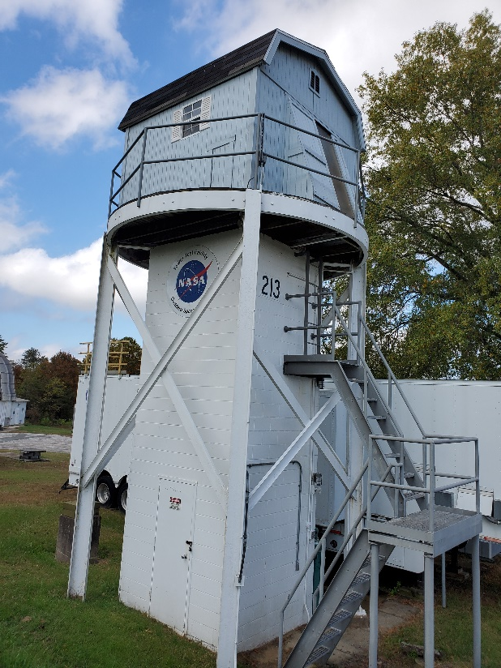
Tower Test Facility (TTF) – Joe Nuth and Don Wegel
The TTF was originally built decades ago to do laser ranging
More recently, the TTF was refurbished, and a test facility was developed to study the possibility of using tethered projectiles (harpoons) to collect samples from a variety of materials and targets. The Tower was originally outfitted with a ballista that accelerated the projectiles into their target. Continued interest in comet sample return along with IRAD funding allowed the Tower to be upgraded with a helium cannon that could launch projectiles at velocities upward of 35 m/s and a Boom Retraction And Deployment (BRAD) system to control the payout of the “tether” that was connected to the projectiles.
This facility and the experiments conducted there were highlighted in a series of magazine articles and Discovery Channel episodes in 2014.

Slide 17
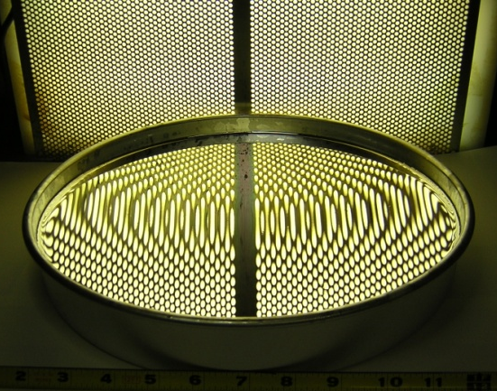
Carbon Nanotube Composite Mirrors – D.M. Rabin and P. C. Chen
GGAO facilities were used to develop carbon nanotube composite mirrors for future space missions. A novel process had also been developed to make ‘moondust’ (lunar regolith simulant) mirrors by spincasting. The process will enable the ISRU (in situ resource utilization) fabrication of multiple large mirrors on the Moon for use in energy generation, mineral extraction, and astrophysical research.
A 12” diameter mirror made by spinning a mixture of ‘moondust’ (lunar regolith simulant JSC-1A) and epoxy.

Slide 18
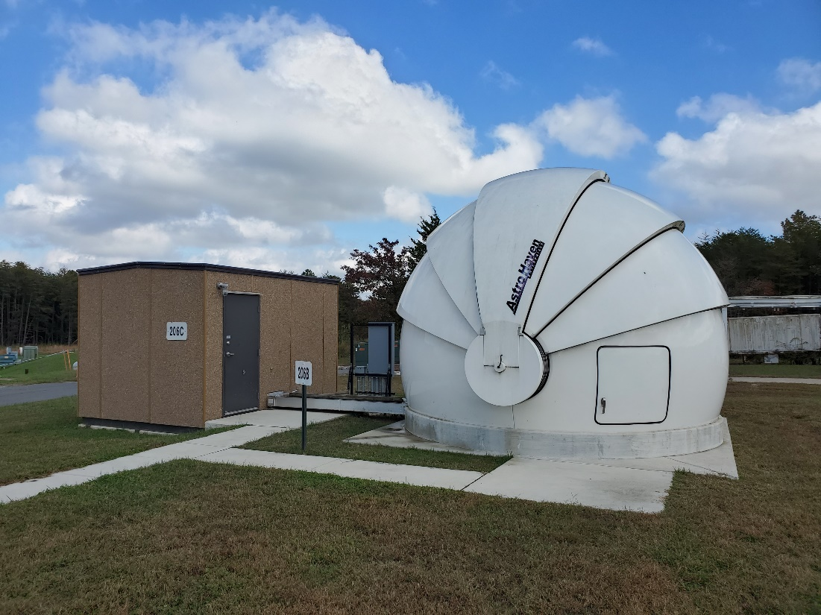
Low Cost Optical Terminal (LCOT) –
Robert Lafon and Armen Caroglanian
Low-Cost Optical Terminal (LCOT) is a prototype laser communications ground terminal that will be used to develop the blueprint for NASA’s future ground terminal network. The goal of LCOT is to use commercial hardware to build a low cost, but flexible, ground terminal that can serve as the building block of a large global network.
The system at GGAO has a 70cm diameter telescope with Adaptive Optics. This facility will be used to test new technology and techniques that will allow the cost of future ground terminals to be reduced. Our goal is to demonstrate the functionality of this ground terminal by using it to transmit to, and receive laser communications from the Artemis mission to the moon.

Slide 19

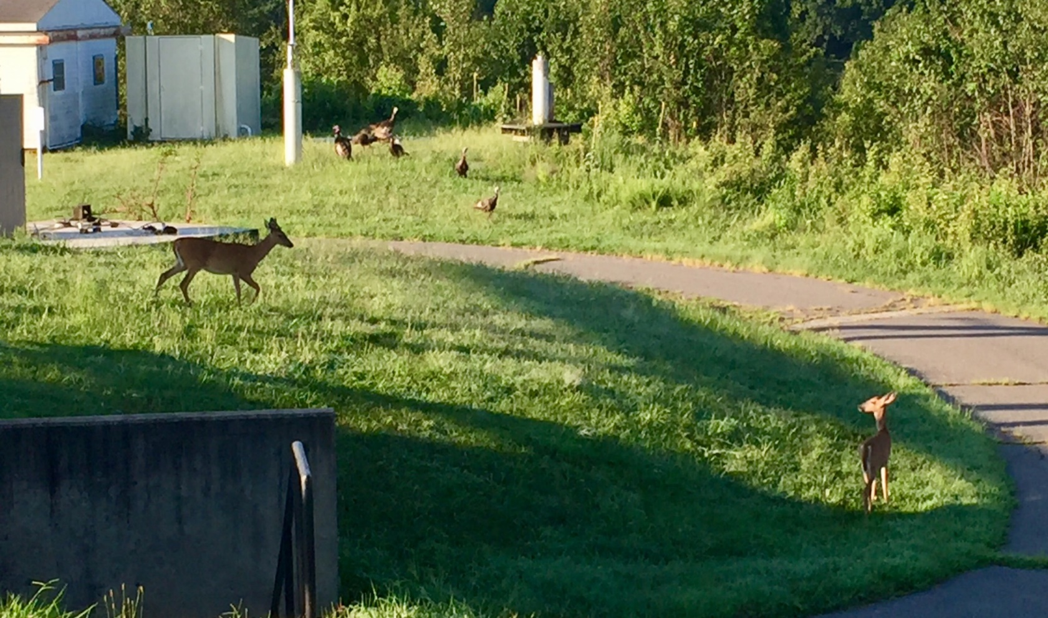
GGAO is also home to many plants and animals
DORIS beacon
Photo courtesy of Paul Beckwith

